Slide 1
Health Biomarkers for Social Research
The Body tells a story

Slide 2




Slide 3
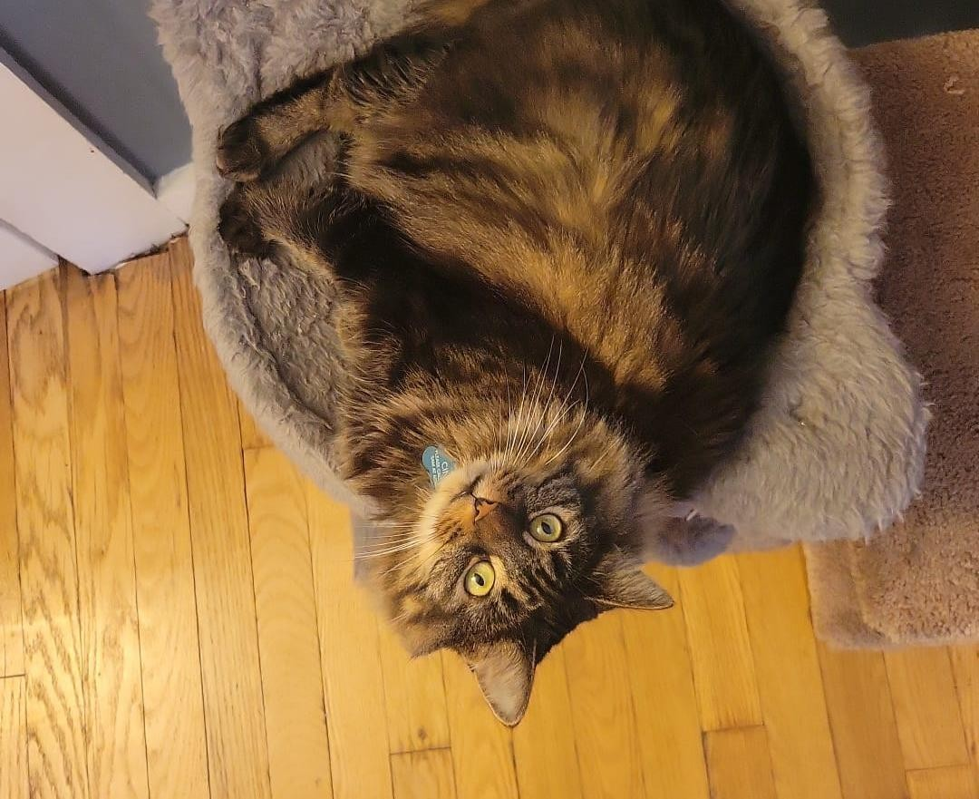
Who’s teaching today?
Samantha De Leon, MD
Panamanian/Argentinian
In Cornell University since 2021
Pursuing a PhD in Human Development and Psychological Sciences
I research Social Neuroscience and Health in the
Life History Lab
sd567@cornell.edu

Slide 4
Agenda
Take snacks and swag!
Goals
Recap from Last Workshop
Biomarkers
Advantages
Challenges
Dried Blood Spot Samples
Procedure for Collection
Laboratory Analysis and Databases
Evaluation

Slide 5
Goal
Goals
Upon completion participants will:
Be able to assess the relevance of incorporating biomarker measures into their research.
Be able to assess the methodological challenges of incorporating biomarker measures into their research.
Have started building a collaborative network towards incorporating biomarker measures into their research.
What’s your goal?

Slide 6

RECAP

Slide 7
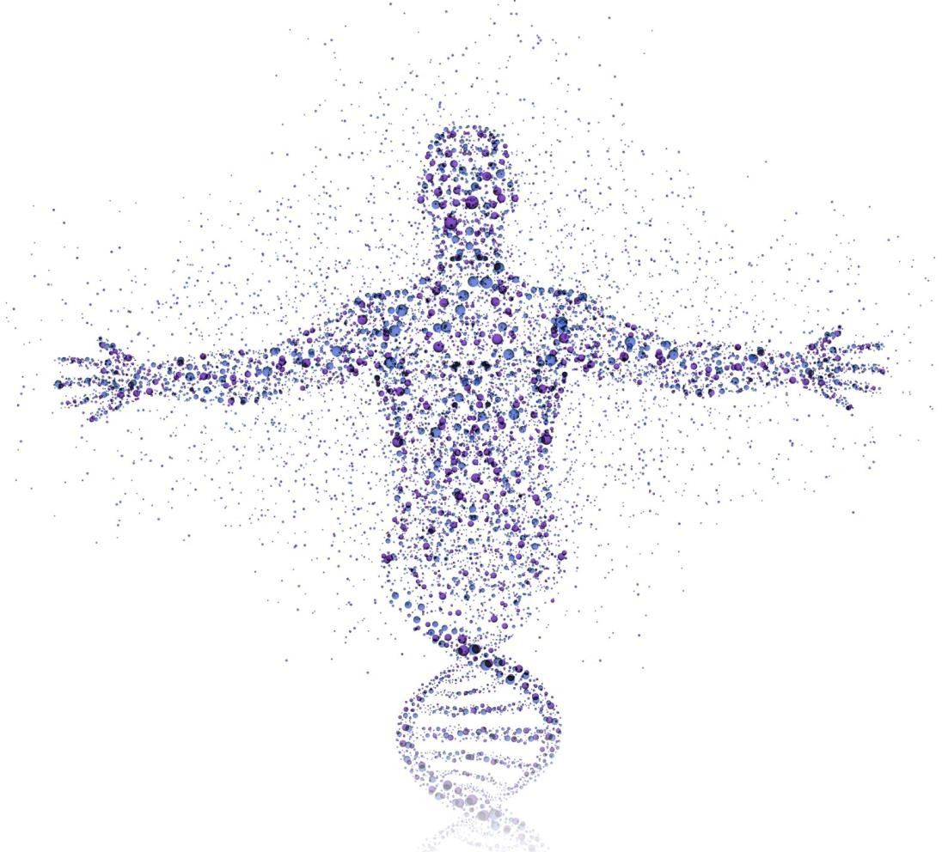
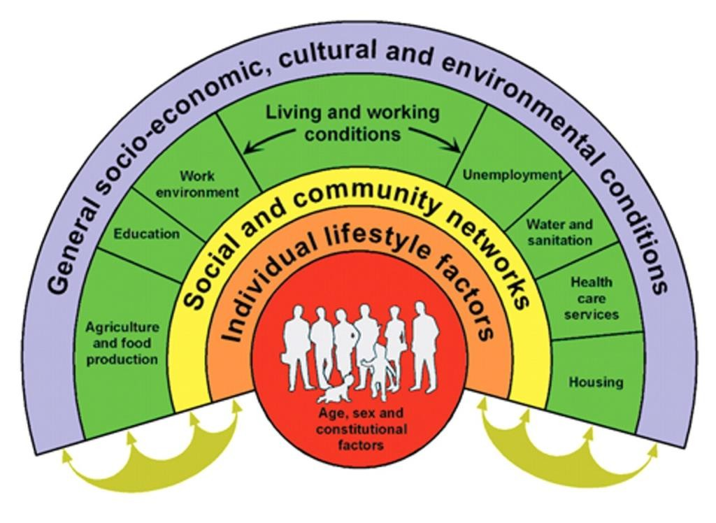
Concepts
Psychosocial contexts affect biological processes.
Multilevel mechanisms
Macro-structural
Pathways
Biological
Community
Interpersonal
Individual
Genetic
Ascendents exposures
In utero
Epigenetic
Neural
Autonomic
Neuroanatomical
Neurofunctional
Neuroendocrine
Cellular and Subcellular
Aging
Mitochondrial
Cardiovascular
Metabolic
Immune
Behavioral
Parenting Styles
Family functioning
Relational
Diet
Sleep
Exercise
Emotion Regulation

Slide 8
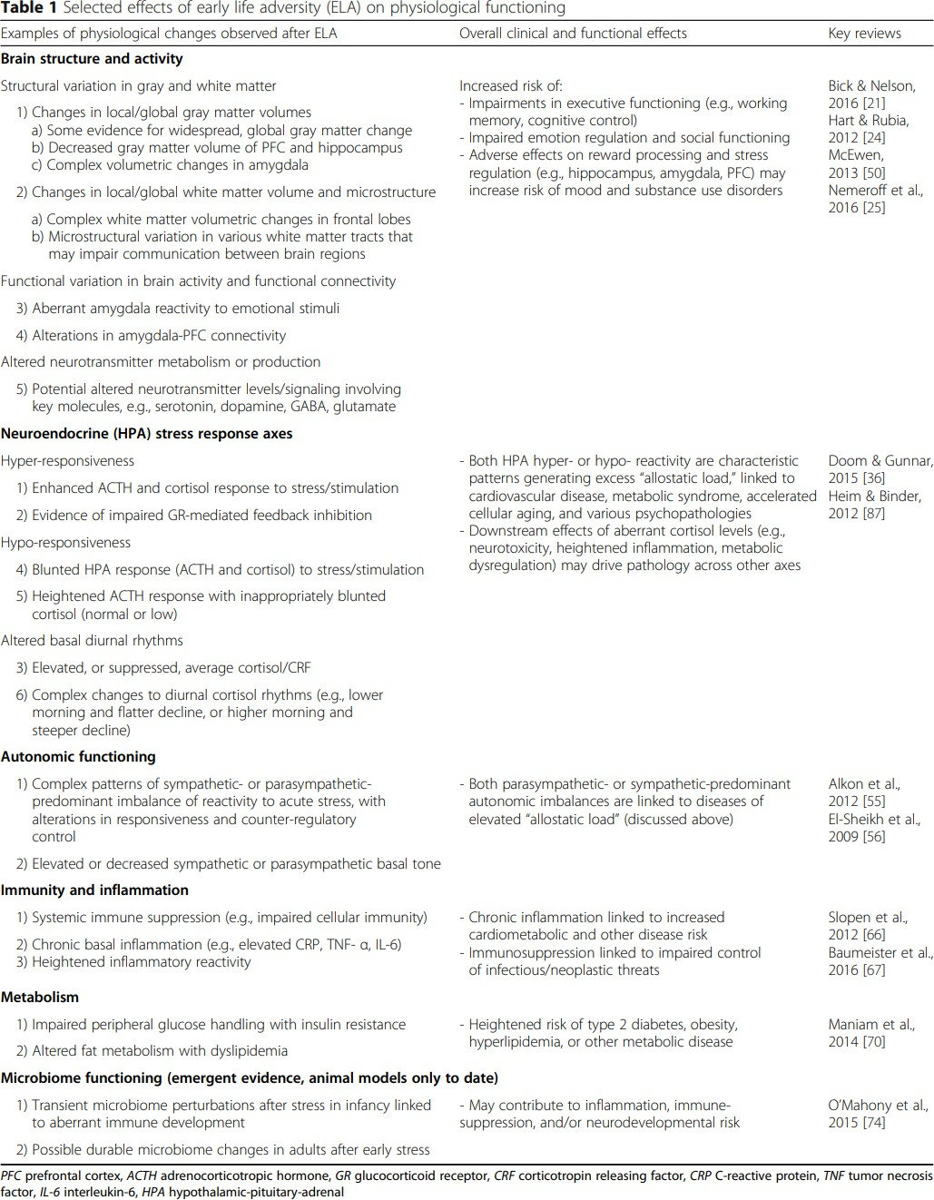
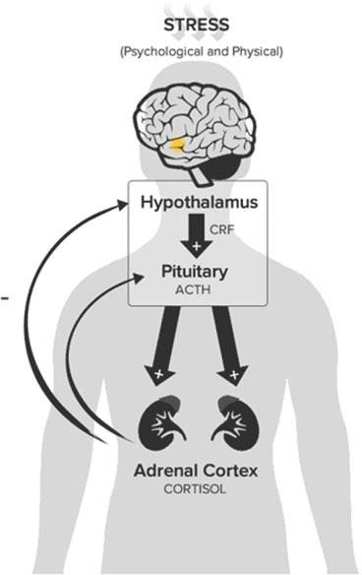
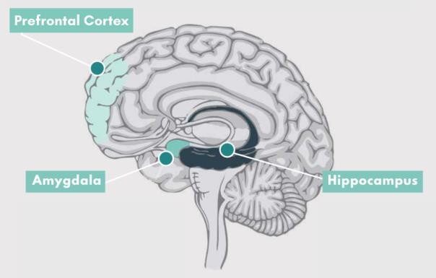
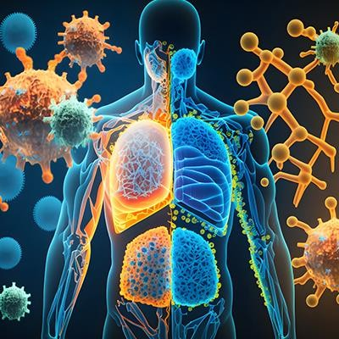
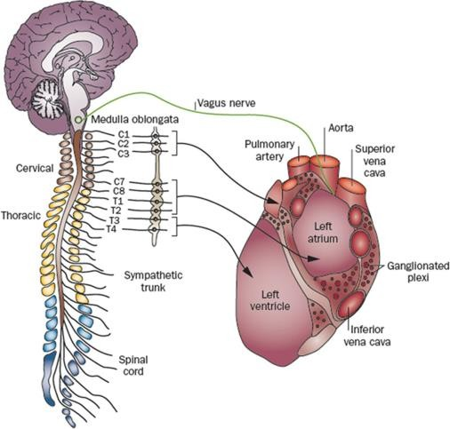
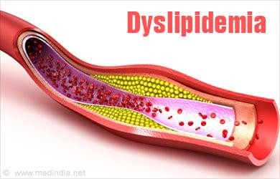
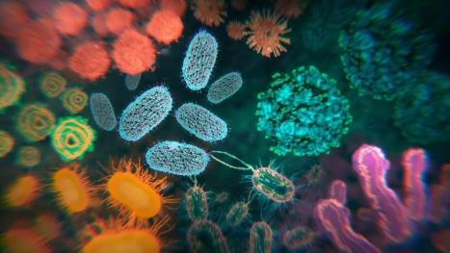
Concepts
Some examples of affected biological processes are:
Berens, A.E., Jensen, S.K.G. & Nelson, C.A. Biological embedding of childhood adversity: from physiological mechanisms to clinical implications. BMC Med 15, 135 (2017). https://doi.org/10.1186/s12916-017-0895-4

Slide 9
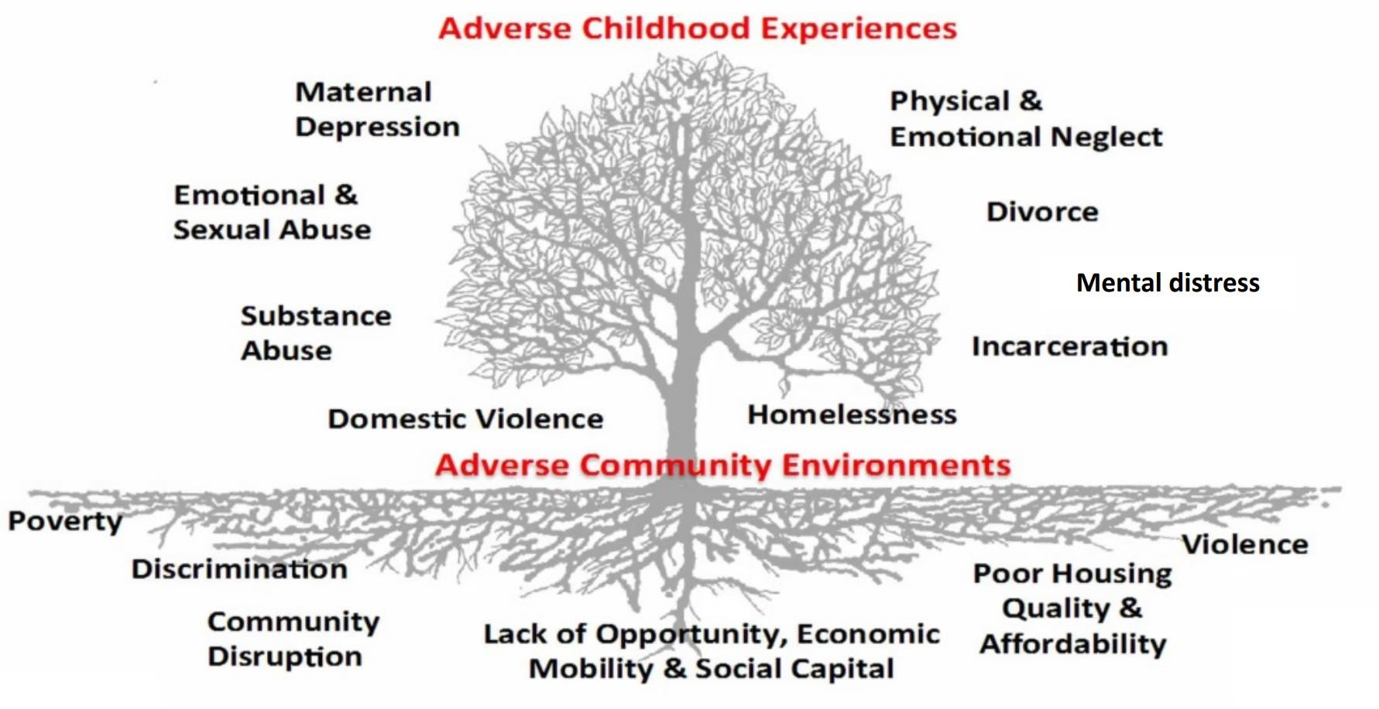
Taken from Farah Qureshi, ScD Assistant Professor Department of Population, Family & Reproductive Health Johns Hopkins Bloomberg School of Public Health July 16, 2024, Life course perspectives in psychosocial epidemiology, Shifting from a deficit orientation to strengths-based models

Slide 10
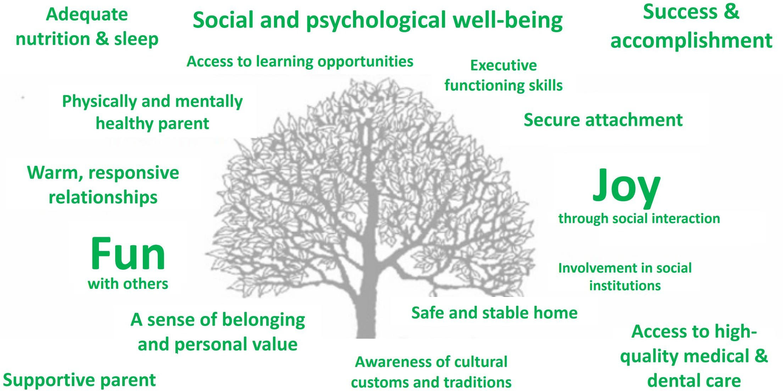
Sege & Browne, 2017. Academic Pediatrics. 17(7): S79-85.

Slide 11
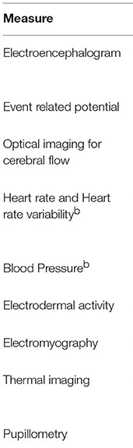
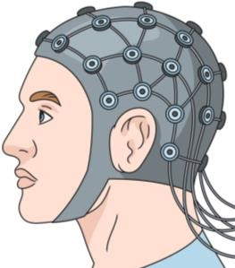
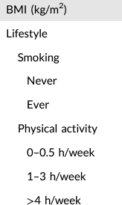
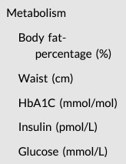
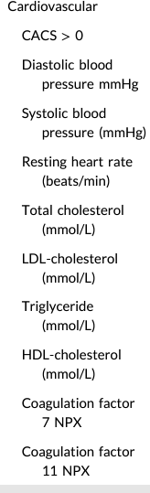
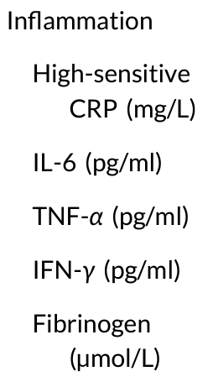
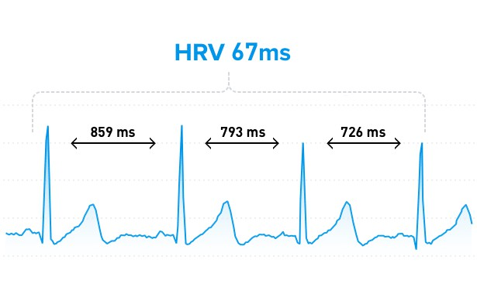
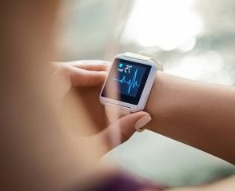
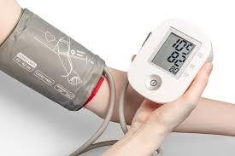
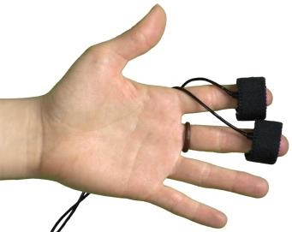
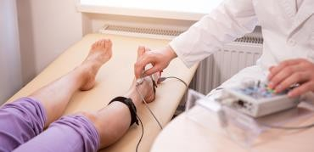
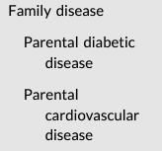
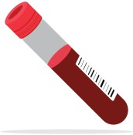
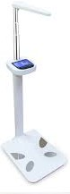
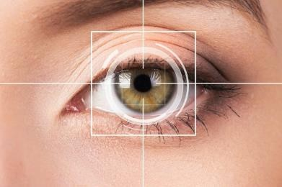
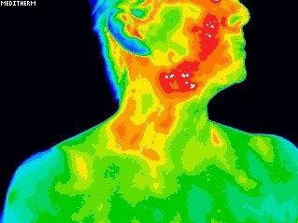
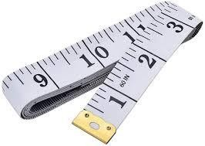
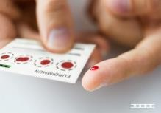
Some ways to measure biological processes are:
A moment
Measures
vs
A Lifetime
Lohani Monika, Payne Brennan R., Strayer David L., A Review of Psychophysiological Measures to Assess Cognitive States in Real-World Driving, Frontiers in Human Neuroscience, 13 2019, https://www.frontiersin.org/journals/human- neuroscience/articles/10.3389/fnhum.2019.00057, 10.3389/fnhum.2019.00057, 1662-5161
Kempel MK, Winding TN, Lynggaard V, Brantlov S, Andersen JH, Böttcher M. Traditional and novel cardiometabolic risk markers across strata of body mass index in young adults. Obes Sci Pract. 2021 Jun 1;7(6):727-737. doi: 10.1002/osp4.528. PMID: 34877012; PMCID: PMC8633932.

Slide 12
What did you find most useful or interesting from the Psychophysiological Measures for Social Sciences workshop?

Slide 13
BIOMARKERS, ADVANTAGES, AND CHALLENGES

Slide 14
Biomarker
A “Objective” Biological Observation
Physical Measures
They show us biological states that may be physiological or pathological
Height and Weight
Waist and Hip Ratio
Heart and Respiratory Rate
Blood Pressure
They indicate health risk
Cellular, molecular, biochemical Measures derived from biological specimens like tissues, cells, or fluid
They substitute and ideally predicts a clinical endpoint.
Lipids (Blood)
Cortisol (Saliva)
Norepinephrine Metabolites (Urine)
Halpern CT, Harris KM, Whitsel EA. 2014. Studying family transitions from a systems perspective: the role of biomarkers. In Emerging Methods in Family Research, ed. SM McHale, PR
Amato, A Booth, pp. 127–44. NewYork: Springer

Slide 15
Examples of biomarkers
BMI
Height
Weight
Waist to Hip Ratio
Arm Circumference
Blood Pressure
Heart Rate
Cardiovascular Reactivity
Cholesterol
Glycosylated Hemoglobin
C-Reactive Protein
Fibrinogen
Interleukin-6
Composite Measures
Cardiovascular Risk
Allostatic Load

Slide 16
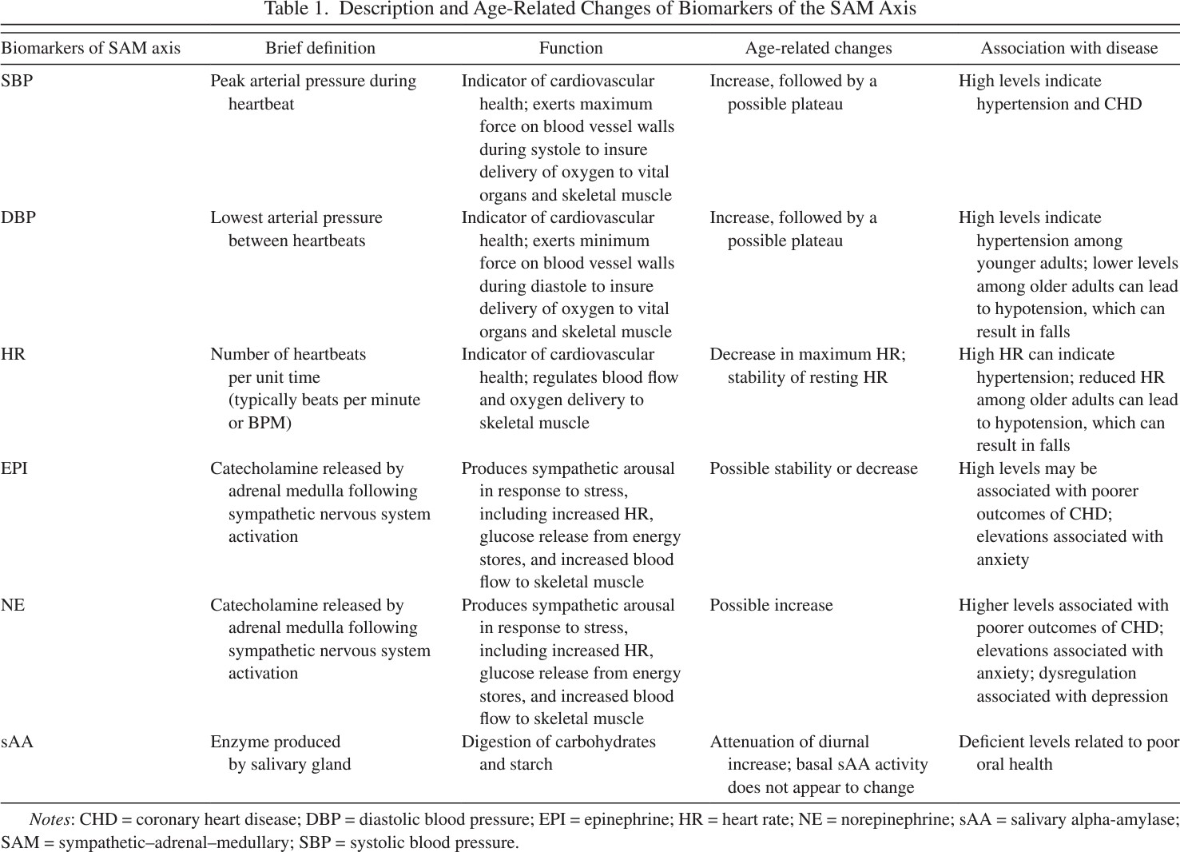
Examples of Biomarkers by Biological System
Piazza, J. R., Almeida, D. M., Dmitrieva, N. O., & Klein, L. C. (2010). Frontiers in the use of biomarkers of health in research on stress and aging. Journals of Gerontology Series B: Psychological Sciences and Social Sciences, 65(5), 513-525.

Slide 17
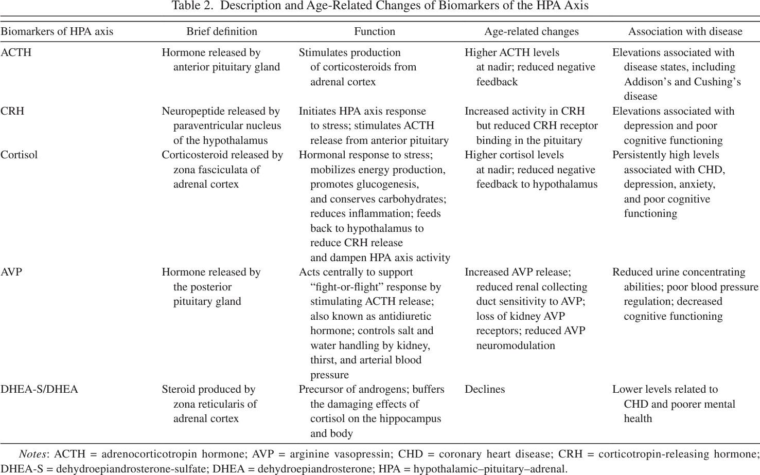
Examples of Biomarkers by Biological System
Piazza, J. R., Almeida, D. M., Dmitrieva, N. O., & Klein, L. C. (2010). Frontiers in the use of biomarkers of health in research on stress and aging. Journals of Gerontology Series B: Psychological Sciences and Social Sciences, 65(5), 513-525.

Slide 18
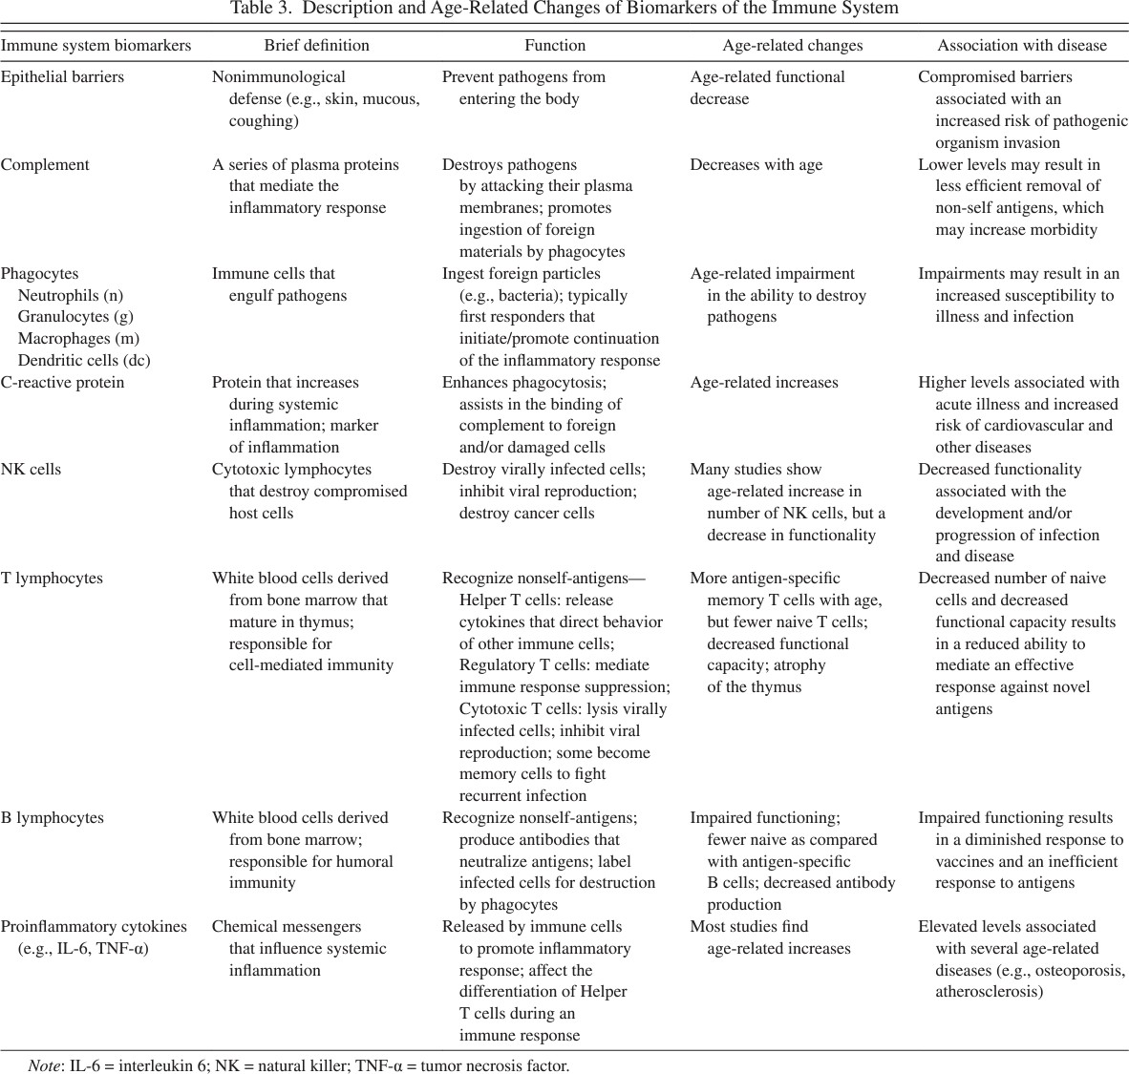
Examples of Biomarkers by Biological System
Piazza, J. R., Almeida, D. M., Dmitrieva, N. O., & Klein, L. C. (2010). Frontiers in the use of biomarkers of health in research on stress and aging. Journals of Gerontology Series B: Psychological Sciences and Social Sciences, 65(5), 513-525.

Slide 19
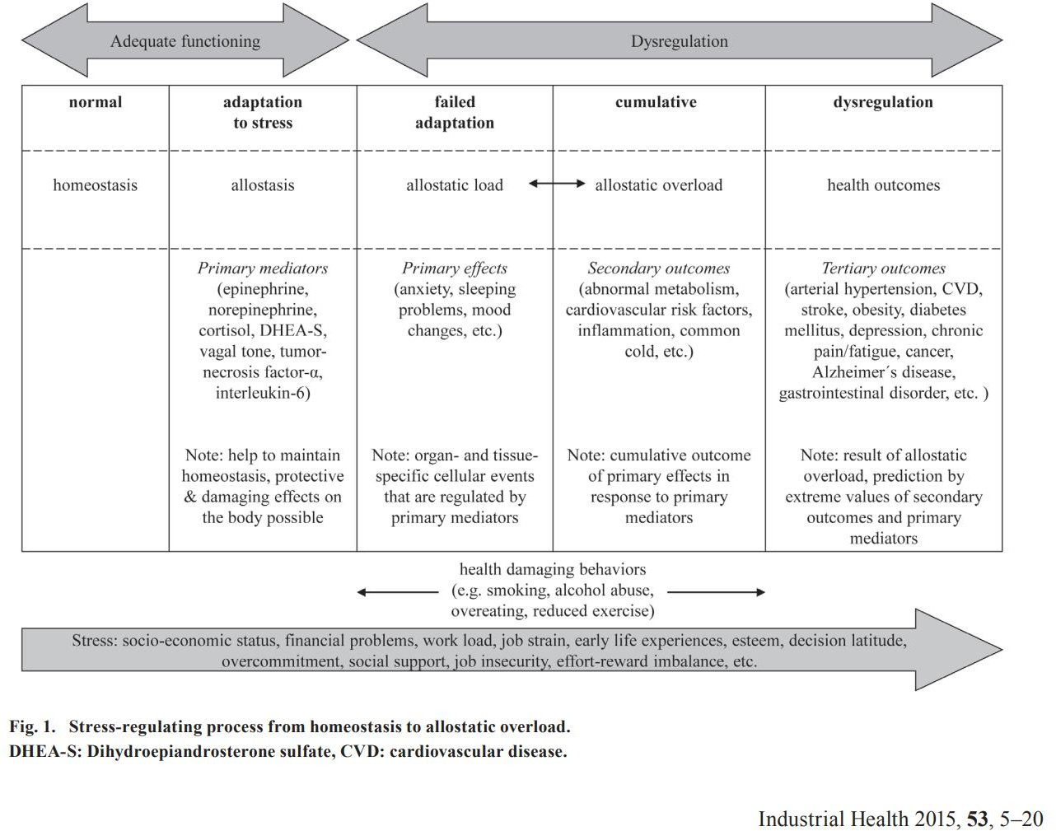
Examples of Composite Measure of Biological Systems
Mauss, D., Li, J., Schmidt, B., Angerer, P., & Jarczok, M. N. (2015). Measuring allostatic load in the workforce: a systematic review. Industrial health, 53(1), 5-20.

Slide 20
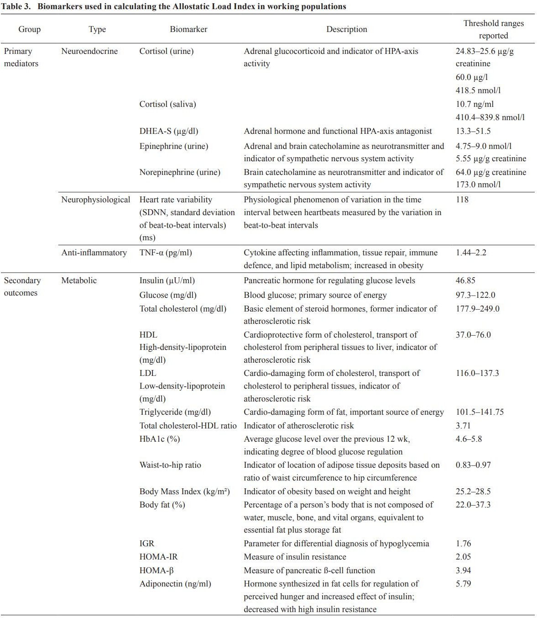
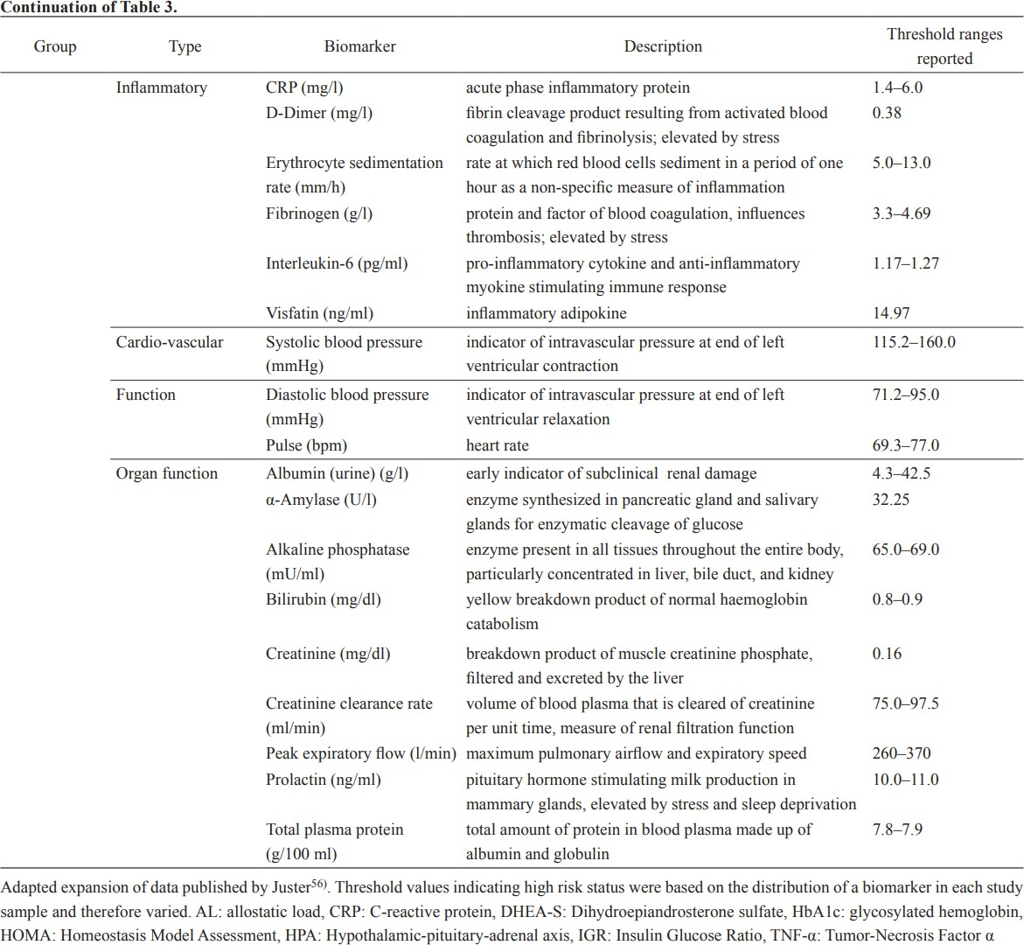
Examples of Composite Measure of Biological Systems
Mauss, D., Li, J., Schmidt, B., Angerer, P., & Jarczok, M. N. (2015). Measuring allostatic load in the workforce: a systematic review. Industrial health, 53(1), 5-20.

Slide 21
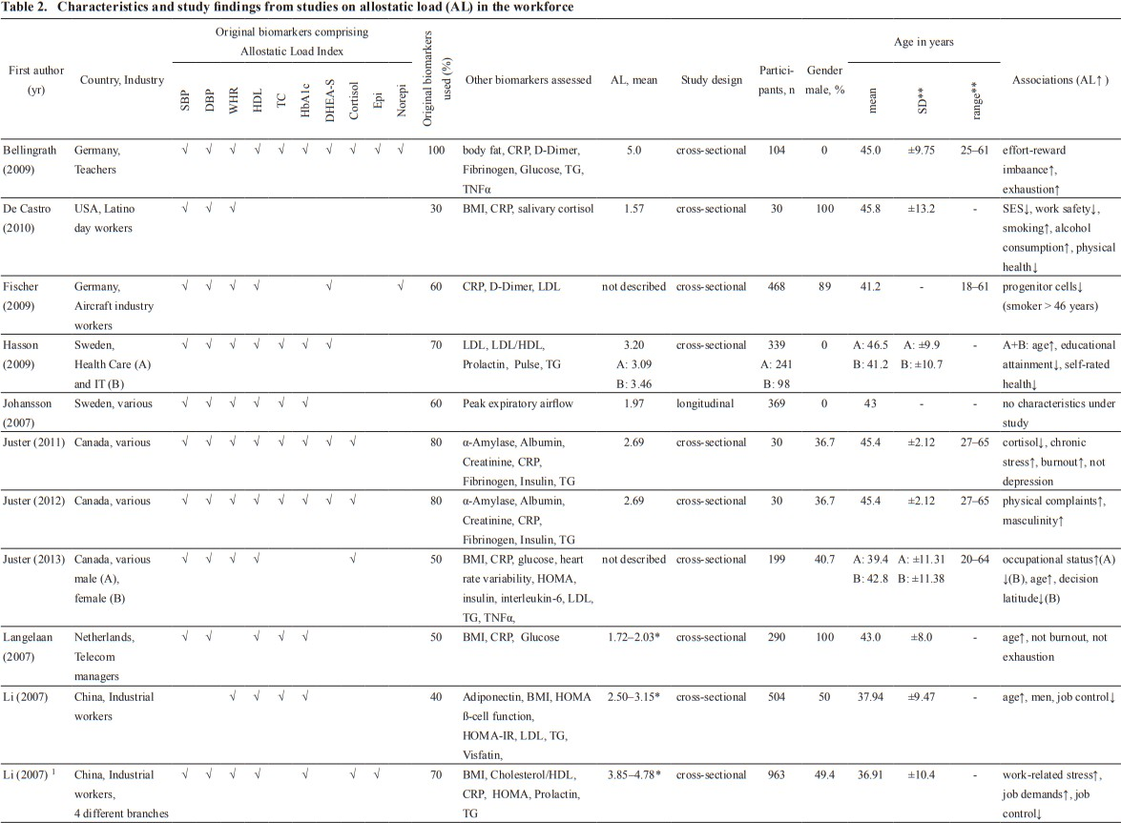
Examples of Composite Measure of Biological Systems
Mauss, D., Li, J., Schmidt, B., Angerer, P., & Jarczok, M. N. (2015). Measuring allostatic load in the workforce: a systematic review. Industrial health, 53(1), 5-20.

Slide 22
Positive Biomarkers?
HDL
Sleep quality
Vagally-mediated Heart Rate Variability
Mitochondrial Function
Endorphins
Dopamine
Opioid peptides
Oxytocin

Slide 23
Advantages of biomarkers
More objective
More reliable (i.e. undiagnosed hypertension)
Robust to cultural and language obstacles
Calibrate or validate self-reports
Identify mechanisms that relate exposure to outcome
Delineate events between exposure and disease
Identify early events in natural history
Reveal distribution of health and disease
Establish dose-response
Illuminate the individual, household and community level variables that account for it
Shed light on reciprocal links between environment and health
Some people prefer slight physical discomfort than the discomfort of disclosing sensitive information
Not a higher order of evidence, but a complimentary one
Harris, K. M., & Schorpp, K. M. (2018). Integrating biomarkers in social stratification and health research. Annual review of Sociology, 44(1), 361-386.

Slide 24
Pitfalls of Biomarkers
Added risk
Logistics
Biosafety
Training
Cost
Abnormal results
Confidentiality
McDade, T. W., Williams, S., & Snodgrass, J. J. (2007). What a drop can do: dried blood spots as a minimally invasive method for integrating biomarkers into population-based research. Demography, 44(4), 899-925.

Slide 25
What is a biomarker that has already been studied in your field or one that you are interested in studying?

Slide 26
DRIED BLOOD SPOT SAMPLES, COLLECTION AND ANALYSIS

Slide 27
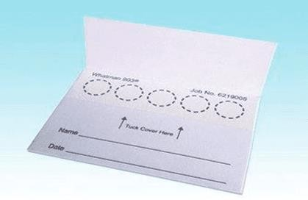
Dried Blood Spot Cards
1960 Guthrie
High-purity Cotton
CDC

Slide 28
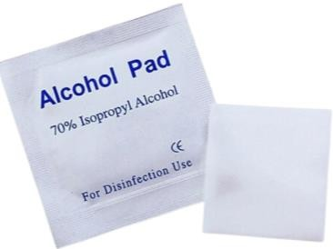
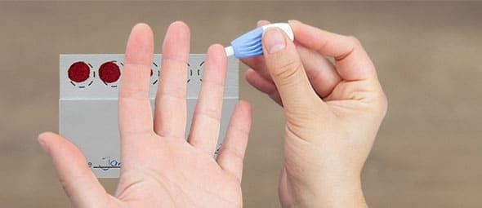
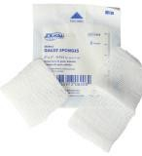


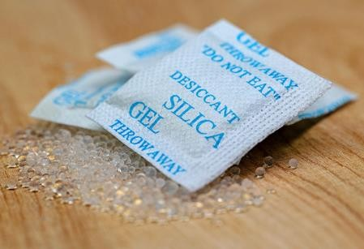
DBS Procedure
Clean participant’s finger with ispropyl alcohol
Prick with sterile, disposable lancet
Wipe first drop away with gauze
Apply subsequent drop to filter paper
Let sample dry 4 - 48 hours
Store with desiccant in resealable plastic bag or container
Can be shipped domestically without special packaging or permitting
Analysis are comparable to plasma/serum protocols after bringing it into solution

Slide 29
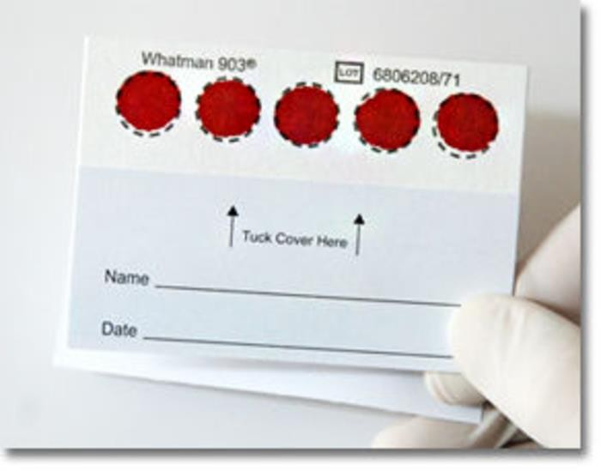
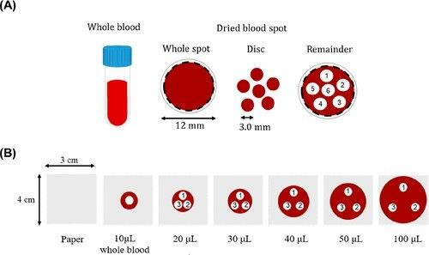
DBS Procedure
In Cornell:
HMRU MVR-West 2nd floor
performs DBS
Life Science Lab HEB 207 Freezer
Do not blot or smear blood on paper
Allow a drop of blood to form on the finger then absorb with the filter paper without direct contact between finger and paper

Slide 30
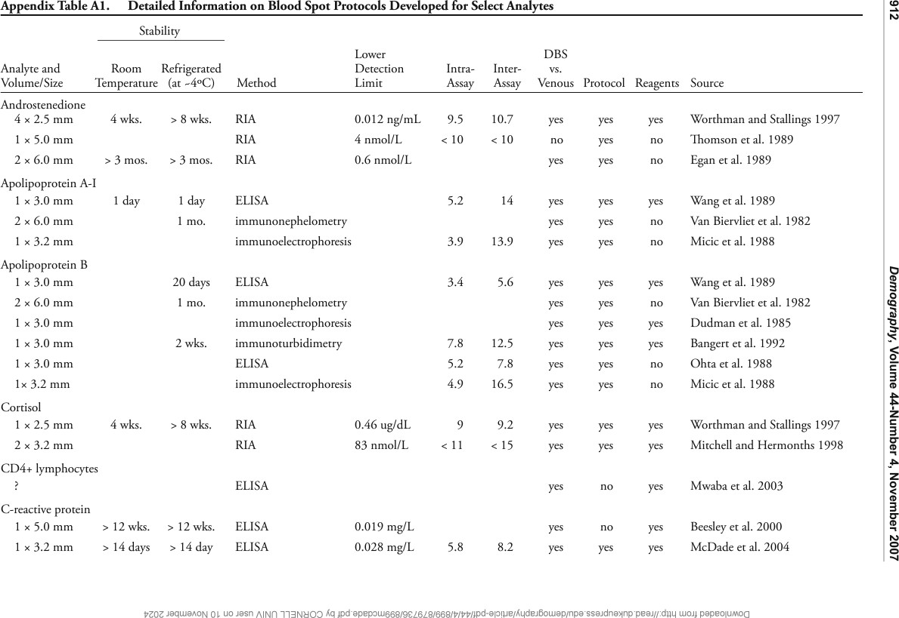
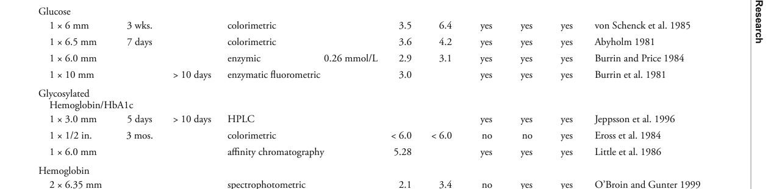

Slide 31
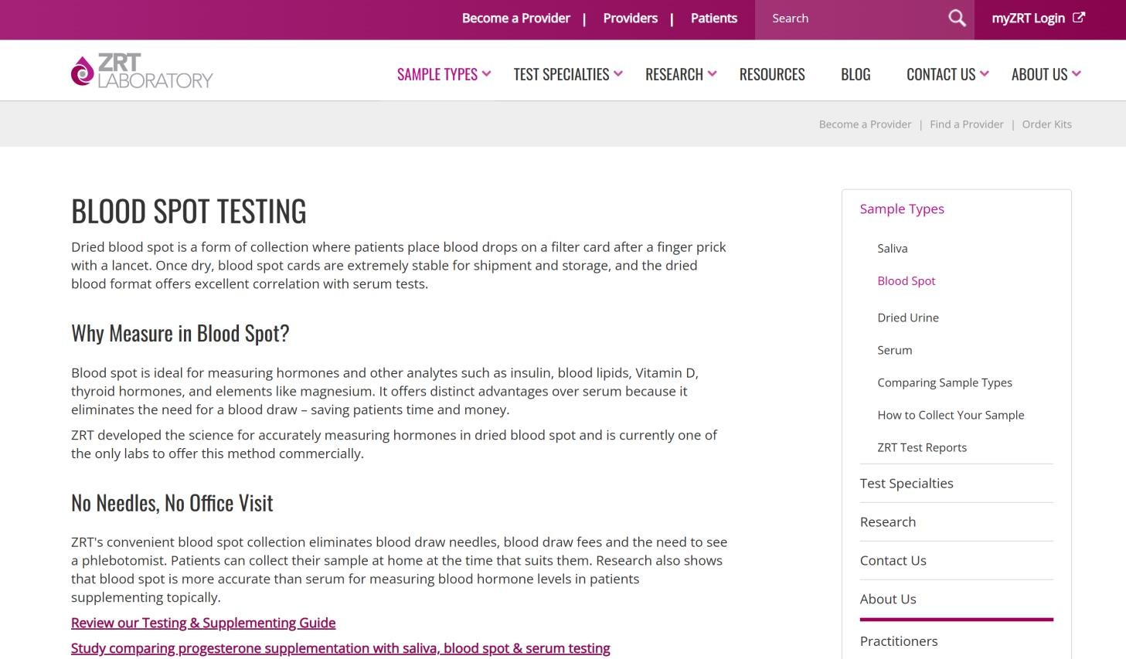
Cost
DBS card $1.5 - $2
Laboratory analysis $5 – $20
Laboratory-grade freezers
$3000 - $5000
Cardiometabolic Profile: insulin, hsCRP, HbA1c, triglycerides, cholesterol, HDL, LDL, and VLDL $84

Slide 32
What do you think would be the greatest challenge to implementing the use of DBS in your research?

Slide 33
Secondary Data
National Health and Nutrition Examination Study (NHANES):
Most influential, Traveling Van, Probability Sample of National Population, Gold Standard for Population health data in the US
National Longitudinal Study of Adolescent to Adult Health (AddHealth):
National probability Sample, 7-12 yo in the 90’s, 5 waves up to 2018, rich contextual data, 2001 urine+saliva >15 000, blood and genetic assays
National Survey of Midlife Development in the United States (MIDUS):
National probability sample, 1995 – 2028 4 waves, 2000s > 3 000 BP and DBS for diabetes, inflammation, cholesterol, and immune function
Health and Retirement Study (HRS):
National probability sample, 2000s BP and DBS for diabetes, inflammation, cholesterol, and immune function

Slide 34
Life Course Perspective: Causality in Longitudinal Studies
Sensitive Period Model
Latent effects
Accumulation Life Course Model
Additive and interactive exposures to recurrent or diverse stressors
Pathway Model
Chains of risk
Social mobility Model
Trajectories of mobility

Slide 35
Secondary Data
ABCD Open source
MESA
CARDIA
Global Flourishing Study
ARIC
MIDUS

Slide 36
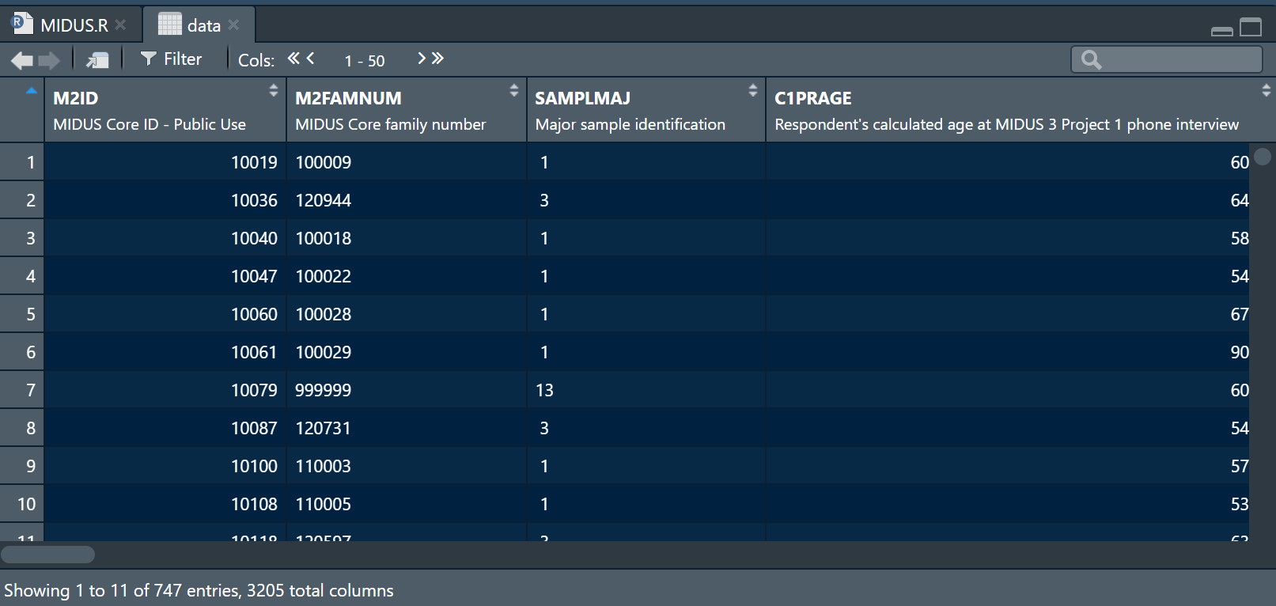

Slide 37

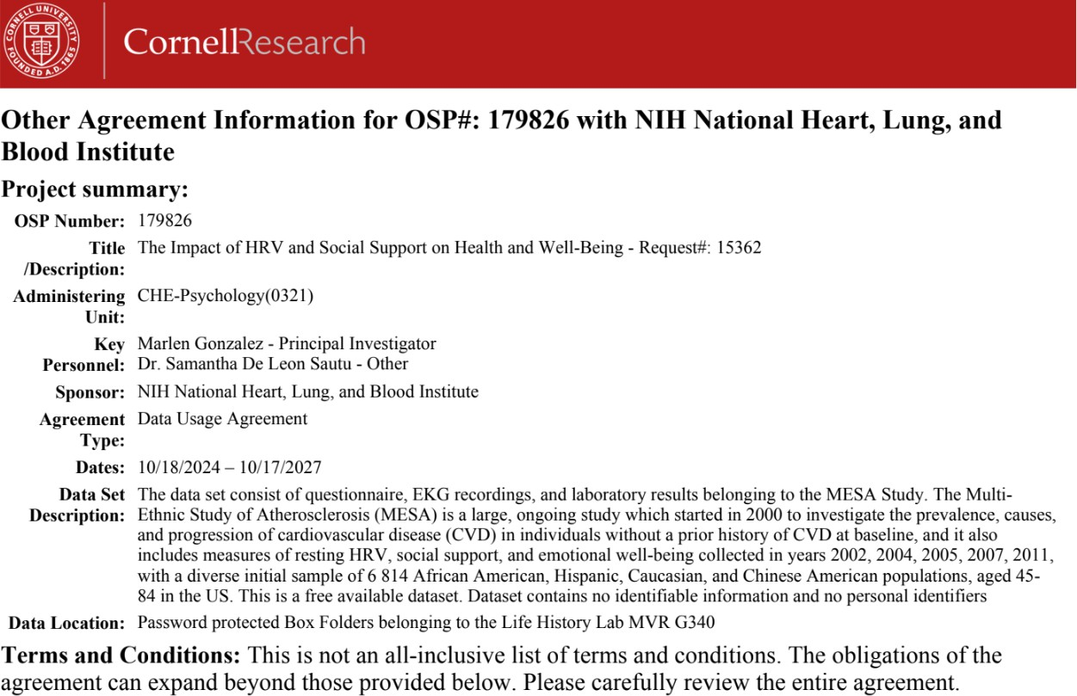
Data User Agreement

Slide 38
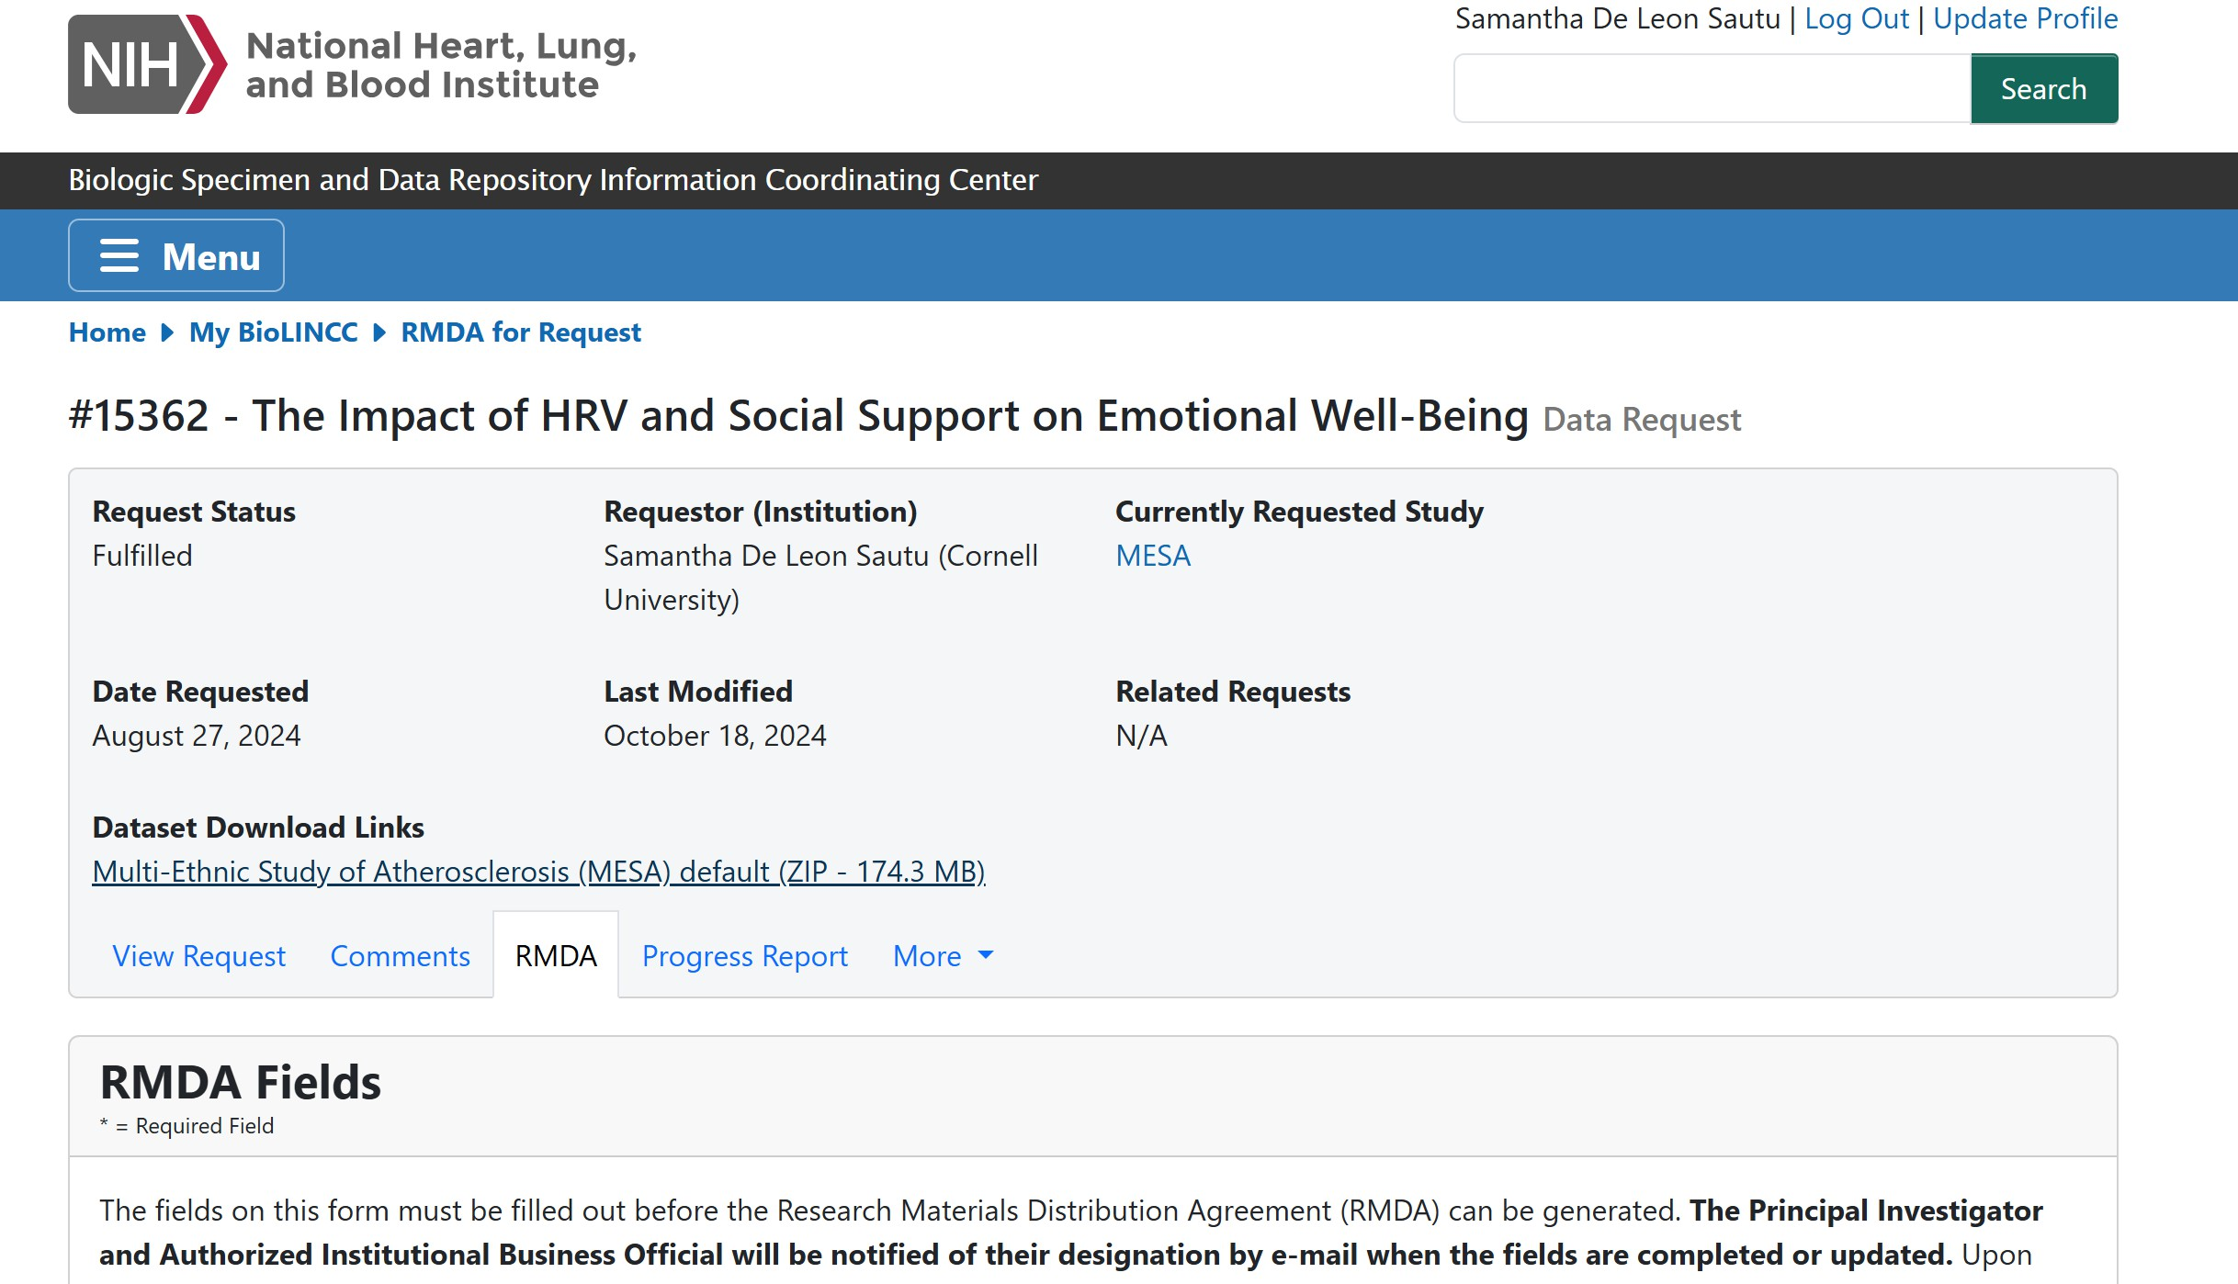
BIOLINCC

Slide 39


Slide 40

CCSS Other Resources
Request for data
https://socialsciences.cornell.edu/research-support/request-data

Slide 41

CCSS Other Resources
Data Archive
https://archive.ciser.cornell.edu/

Slide 42

Evaluation

